Slide 1
Group 14 - LAzada
Instructor: Tri Dang Tran
Team Member:
Dinh Pham : S3878568
Loc Phan : S3938497
Kien Chau: S3790421

Slide 2
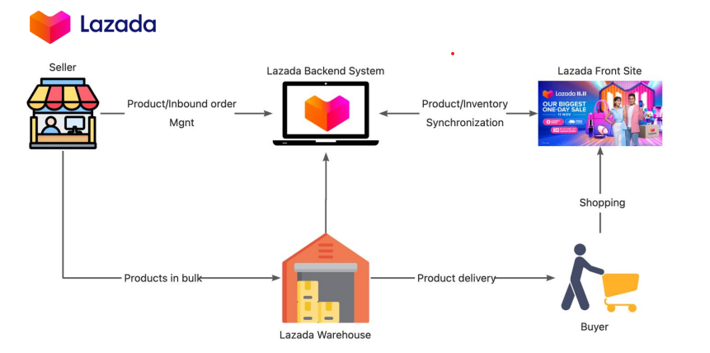
Application
Mini Lazada
Seller
Customer
Admin

Slide 3
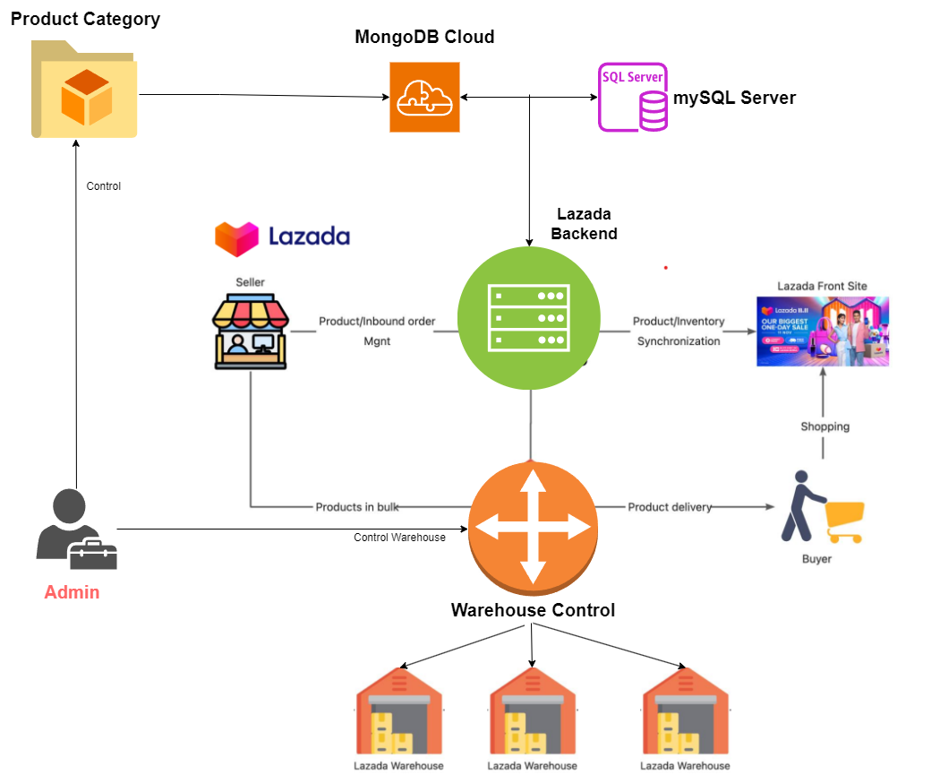
Database Analysis

Slide 4
Customer

Slide 5
Seller

Slide 6
ADmin

Slide 7
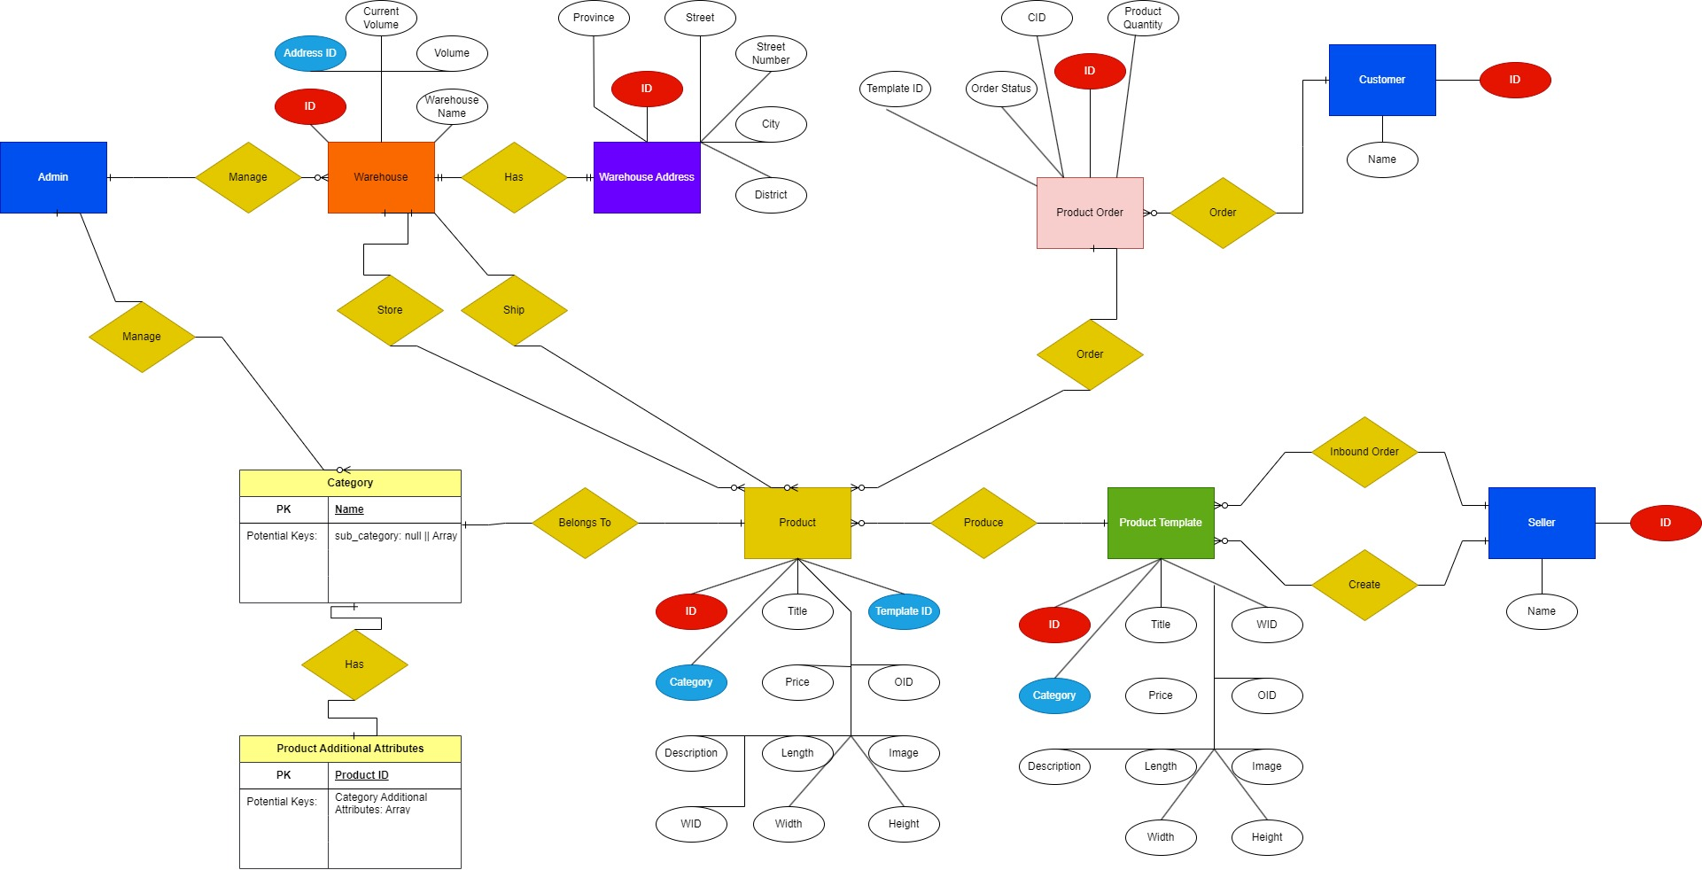
Database design
MySQL Server
mongoDB

Slide 8
Thank you for listening It’s demo time!

